Slide 1

HR Analytics
Group:
Aryama Ray
Arvind Kumar
Anand Naik
Chetankumar Trivedi

Slide 2

Problem Statement
Problem Statement: Company is having annual attrition of 15% and that needs replacement of talent pool from job market.
This is bad for the company due to following issues:
Delay meeting projects timelines – Reputation loss amongst customers & partners.
Need recruiting good number of new talents – Sizeable staff is to be maintained in HR.
Lead time to acclimatize new recruits – Need to spend good amount of resources (time, money & energy) in training before they start delivering.

Slide 3
Objective and Deliverables
Objective:
Find out the factors causing attrition using Data Analytics Tools.
Understand the impact of each identified factors on attrition.
And therefore facilitate arriving at…
Changes to be done in workplace to make employees stay.
Deliverables:
Find out probability of attrition using logistic regression model.
Build a robust model which can predict the attrition well.

Slide 4
Modelling Approach
Steps Followed | Activities Carried Out | Actions Executed
Data Acquisition | Identify Data Sources | Five data sources identified and acquired - General Data, Employee Survey Ratings, Manager Survey Rating and Attendance Data. Employee ID found to be unique key across sources.
Data Preparation | De-duplication Missing value treatment Removal of outliers Derive new metrics | Did not find any duplicates across 4410 records. Attendance data Columns with all missing values – Office holiday and hence no attendance, completely removed. Missing values found in pair on some of the dates for few employees - Employee might be on leave or travel and hence not come to office. Did not removed but did not considered for derived metrics. Final dataset – Only 2% of total records were having missing values hence dropped. Monthly Income has a wide range, found outliers and removed. Average time in office is the only newly derived metrics based on attendance data.

Slide 5
Modelling Approach (Contd…)
Steps Followed | Activities Carried Out | Actions Executed
Data Preparation | Binning of categorical variables Normalization of numeric variables Prepare final clean dataset | All categorical variables are logically binned. Found different ranges for different variables. Scaled them to a common range. Some variables have single value, dropped them. Converted all variables to numeric variables – Total 3969 records with 68 variables.
Exploratory Data Analysis | Understand relationship between Attrition and other parameters | Plotted attrition v/s all parameters and found relationship between them.
Build Regression Model | Prepare Training & Test data Build model | Have sufficient records with attrition, hence standard 70:30 ratio taken to prepare training and test datasets. Final model built with only few (# 8) but high impact parameters for stability of model.
Test the Model | Test robustness of model | Model tested with optimal probability cut-off through Sigmoid Curve, Accuracy, Sensitivity, Specificity, KS Statistics and Lift & Gain Chart of the model.

Slide 6
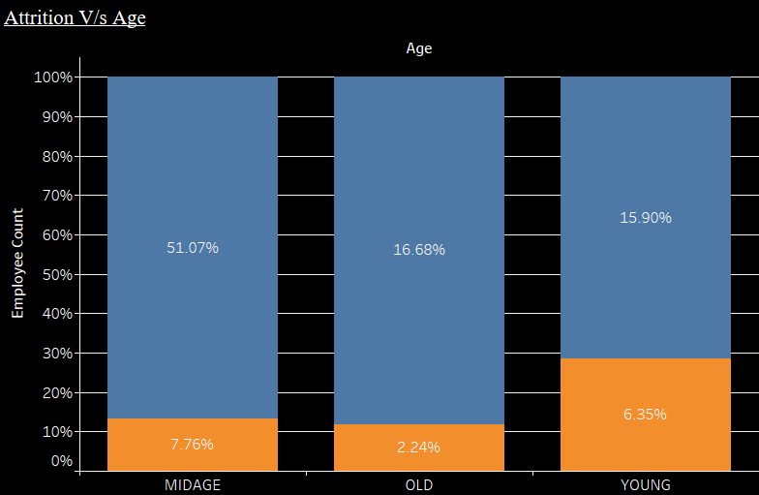
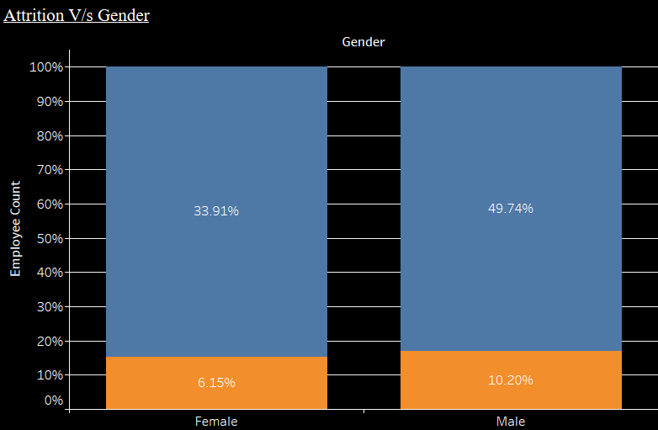
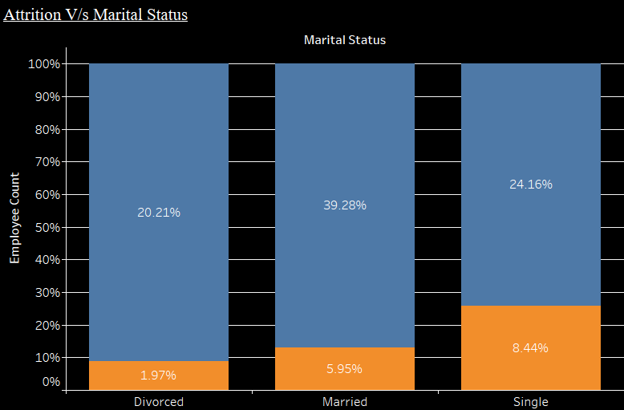
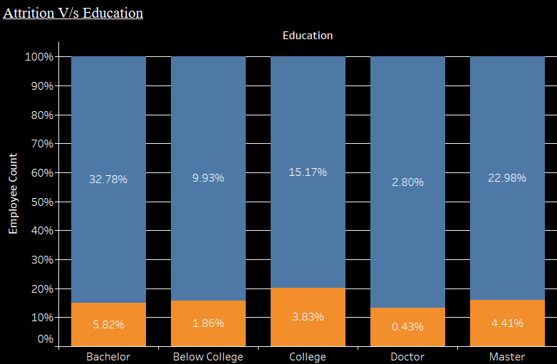
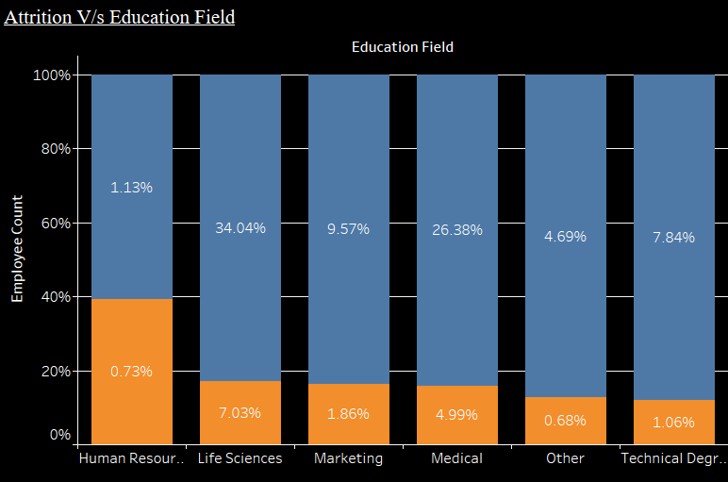
Exploratory Data Analysis (Personal Attributes)
Colour Legends:
Attrition
No Attrition
Observation:
Young professionals contribute more to attrition rate as compared to older ones.
Single employees have more attrition rate both in absolute terms and its own bin.
Education and Gender do not seem to have impact on attrition.

Slide 7
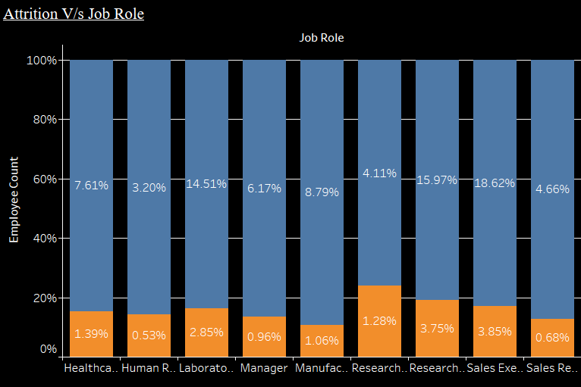
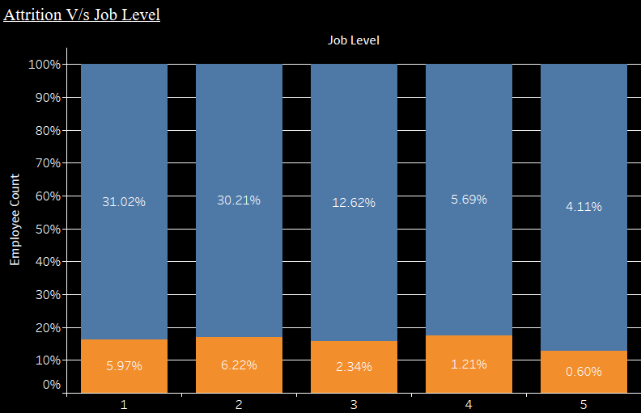
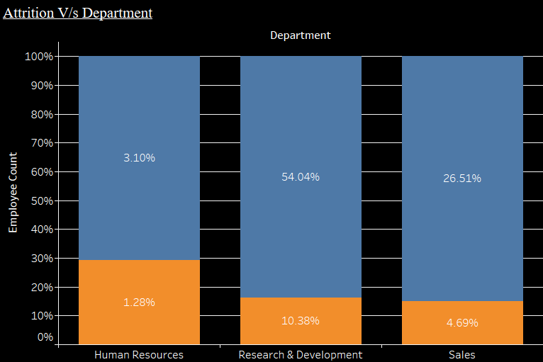
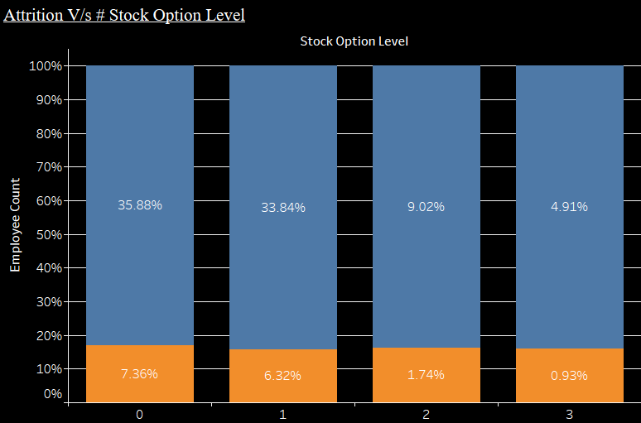
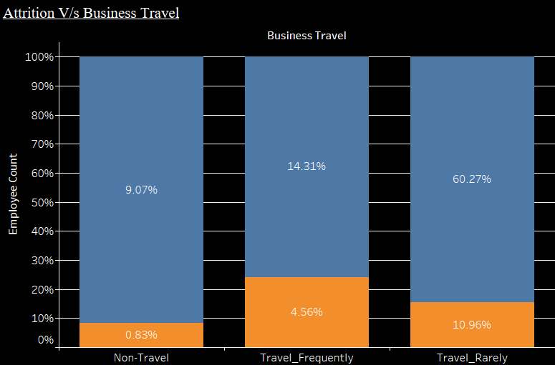
Exploratory Data Analysis (Company Labels)
Colour Legends:
Attrition
No Attrition
Observation:
Attrition rate is evenly distributed across all job roles, job levels and stock option levels.
HR has more % ratio of attrition v/s no attrition. Though absolute % of attrition is low in HR.
Employees travelling frequently are more prone to attrition.

Slide 8
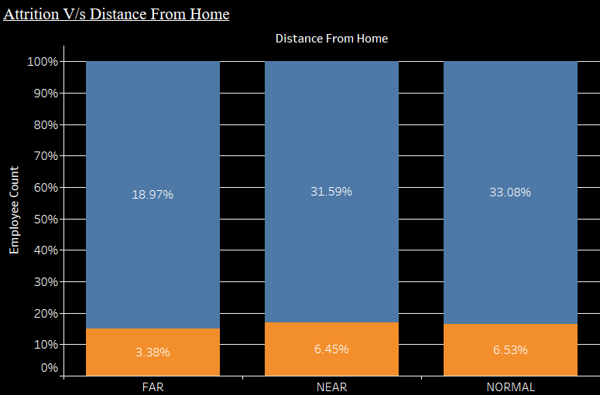
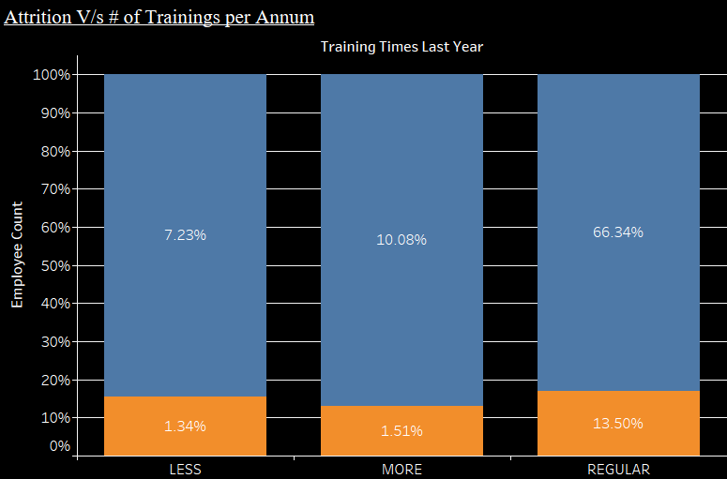
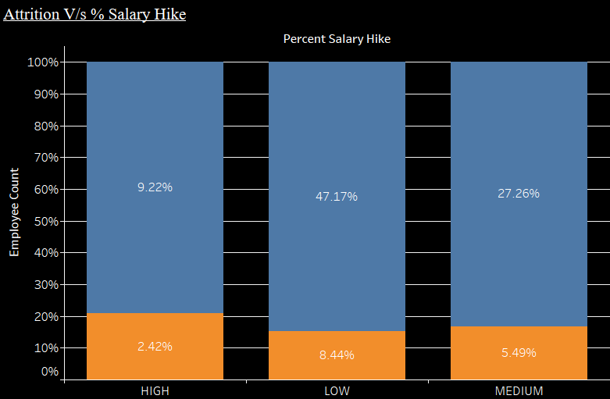
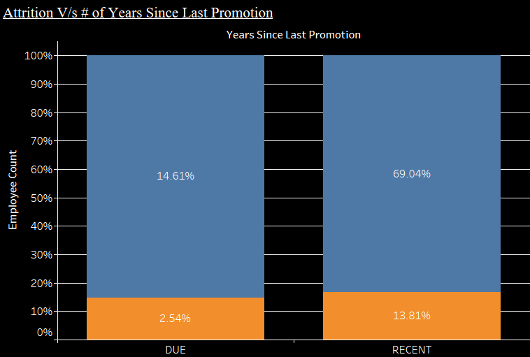
Exploratory Data Analysis (Company Labels)
Colour Legends:
Attrition
No Attrition
Observation:
Travel distance from home to company does not seem to be a significant factor for an attrition.
% Salary hike does not show clear linear relationship with attrition.
Attrition is more amongst employees who have been imparted regular trainings.
It is observed that employees recently promoted have more attrition.

Slide 9
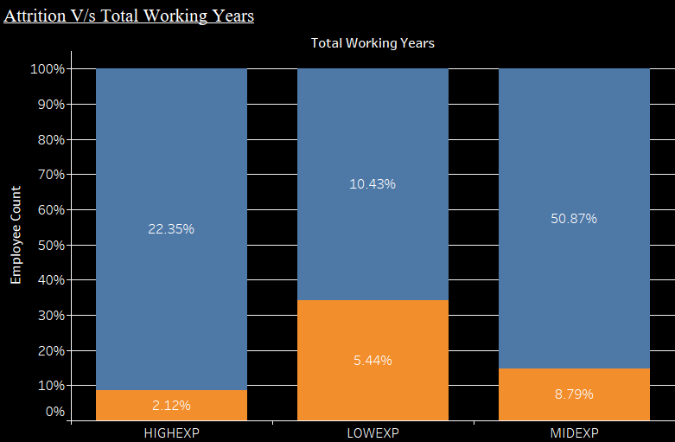
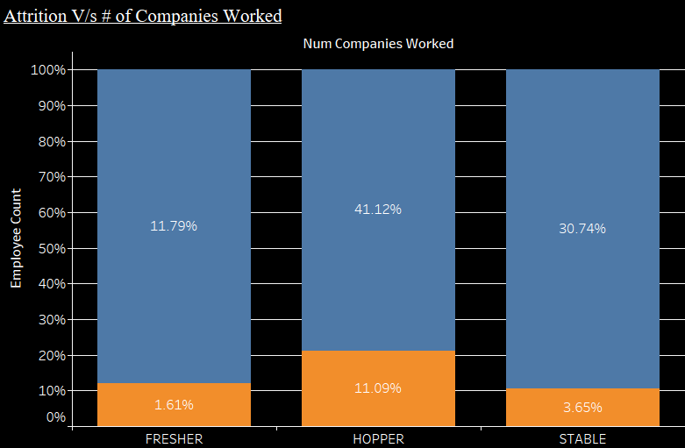
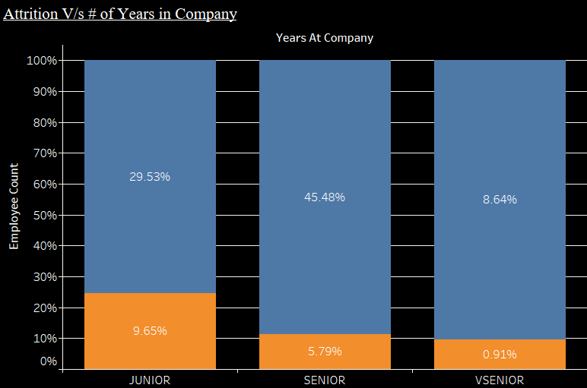
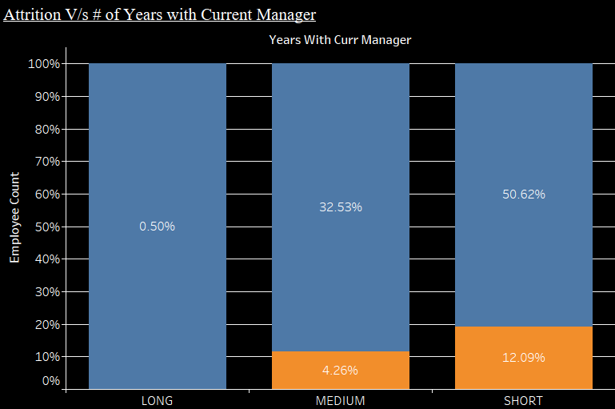
Exploratory Data Analysis (Working History)
Colour Legends:
Attrition
No Attrition
Observation:
Ratio of % Attrition v/s No Attrition is higher for employees having:
lesser total working years
more number of companies worked
lesser working years in company
lesser working years with the same manager
In absolute terms, % attrition is very high for employees who have hopped to many companies in the past.

Slide 10
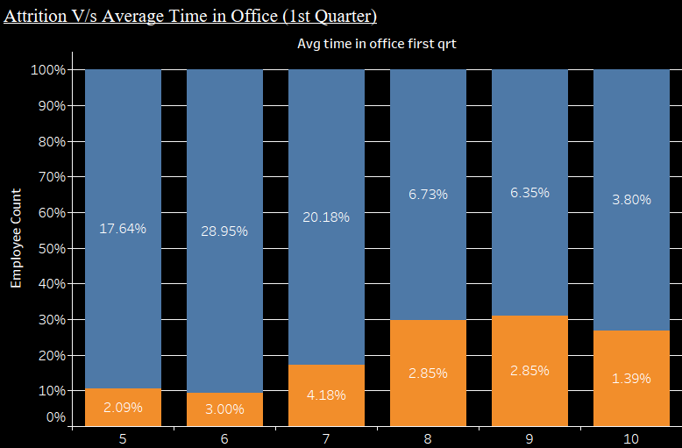



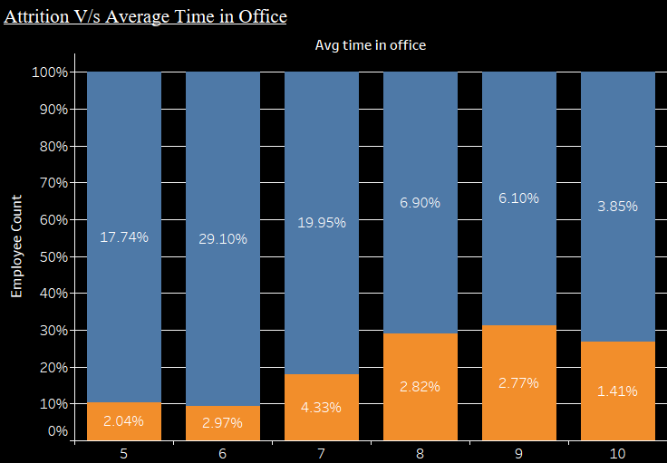
Exploratory Data Analysis (Time in Office)
Colour Legends:
Attrition
No Attrition
Observation:
Attrition is more amongst the employees who stay late in office.
There is a high co-relation amongst these time related variables.

Slide 11
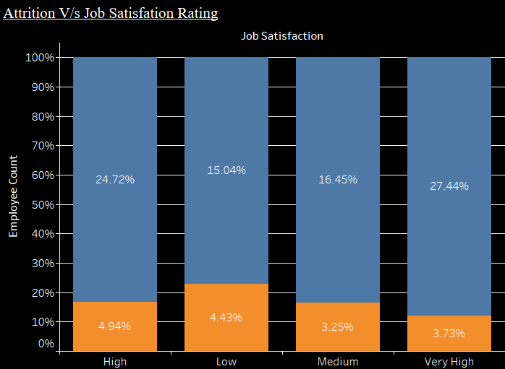
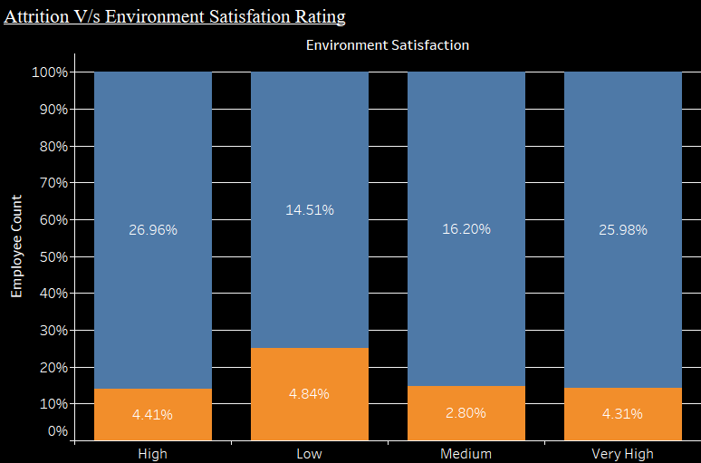
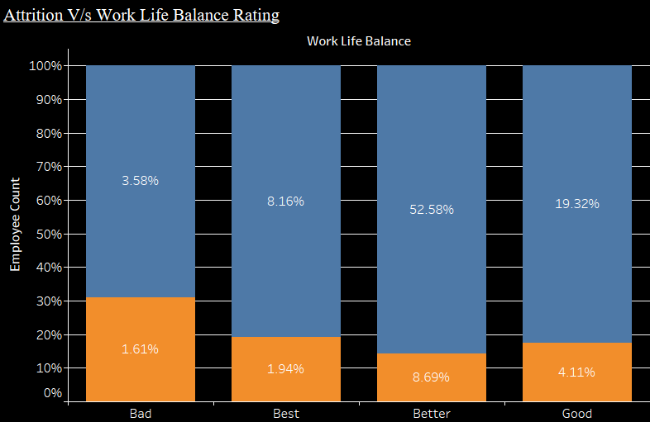
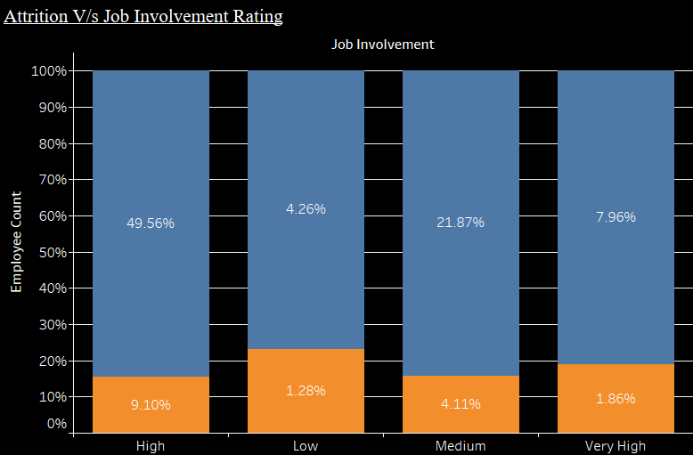
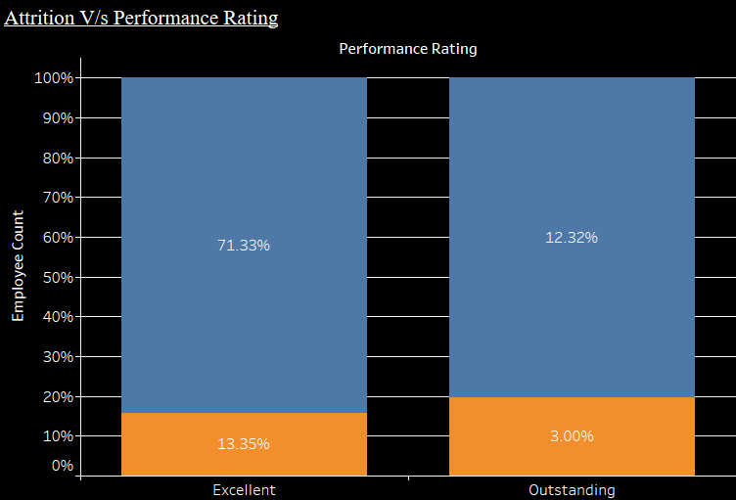
Exploratory Data Analysis (Survey Ratings)
Colour Legends:
Attrition
No Attrition
Observation:
Employees under lower bucket of survey ratings are more likely to leave.

Slide 12
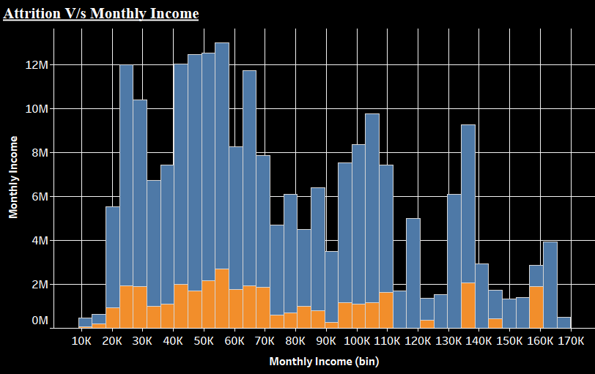
Exploratory Data Analysis (Monthly Income)
Observation: It seems that attrition is distributed across all income levels.

Slide 13
Key Parameters for Attrition (Results of a Model)
Following parameters found to highly impact Attrition as per Regression Model:
Time spent in office – Employees spending more time after schedule departure time are having more attrition (Regular slogging wears you out !!)
Environment Satisfaction – Lower the rating, higher the attrition (It’s an inter-dependable environment)
Job Satisfaction – Lower the rating, higher the attrition (Money alone don’t buy happiness !!)
Age – Attrition is higher in younger set of employees (Age brings more maturity !!)
Business Travel – Employees who has to travel frequently, more tend to leave the company (Indirectly impacts Work Life Balance !!)
Marital Status –Attrition is more in single employees. Married employees seem to be stable at job (More Freedom being Single !!!)
Number of Companies Worked – Employees who have historically worked in more number of companies are more likely to leave faster (Hopping Mentality !!)
Years Since Last Promotion – Employees recently promoted are leaving the company (Leveraging on recent growth to get more growth outside !!)

Slide 14
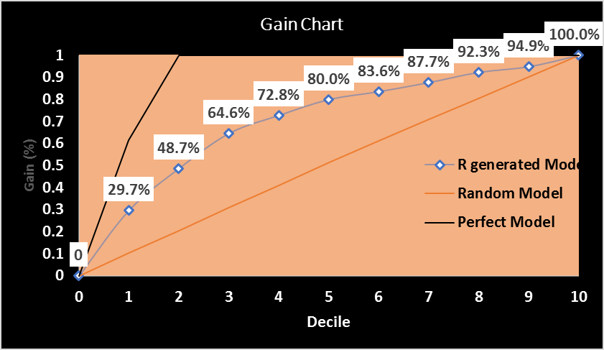
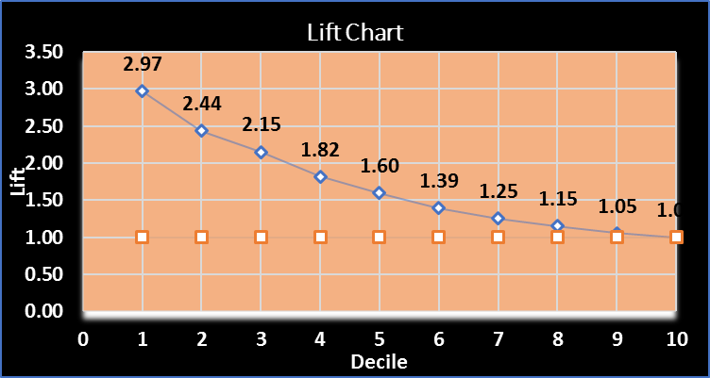
Robustness of Model (Model’s Discriminative Power Measures)
Model has good level of Accuracy = 69.69% , Sensitivity = 68.72% and Specificity = 69.88% at optimal cut-off probability of 0.1616162
It has a decent Gain and Lift as compared to random model.
It has KS Statistics of 41.3% at 3rd decile.

Slide 15
Thank You

